Slide 1
5
Modeling with Higher-Order Differential Equations

Slide 2
5.1
Linear Models: Initial-Value Problems

Slide 3
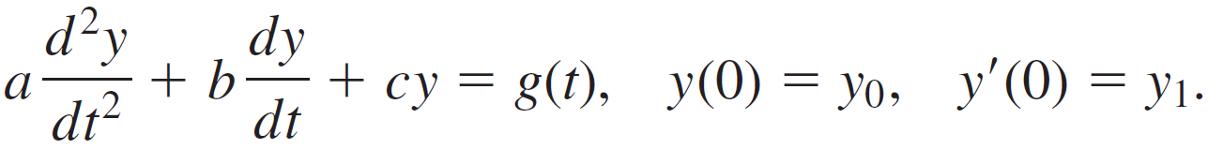
Linear Models: Initial-Value Problems (1 of 2)
Introduction
In this section we are going to consider several linear dynamical systems in which each mathematical model is a second-order differential equation with constant coefficients along with initial conditions specified at a time that we shall take to be t = 0:

Slide 4
Linear Models: Initial-Value Problems (2 of 2)
The function g is variously called the driving function, forcing function, or input of the system.
A solution y(t) of the differential equation on an interval I containing t = 0 that satisfies the initial conditions is called the response or output of the system.

Slide 5
5.1.1 Spring/Mass Systems: Free Undamped Motion

Slide 6
5.1.1 Spring/Mass Systems: Free Undamped Motion (1 of 27)
Newton’s Second Law
When a mass m is attached to the lower end of a spring of negligible mass, it stretches the spring by an amount s and attains an equilibrium position (or rest position) at which its weight W is balanced by the restoring force ks of the spring.

Slide 7
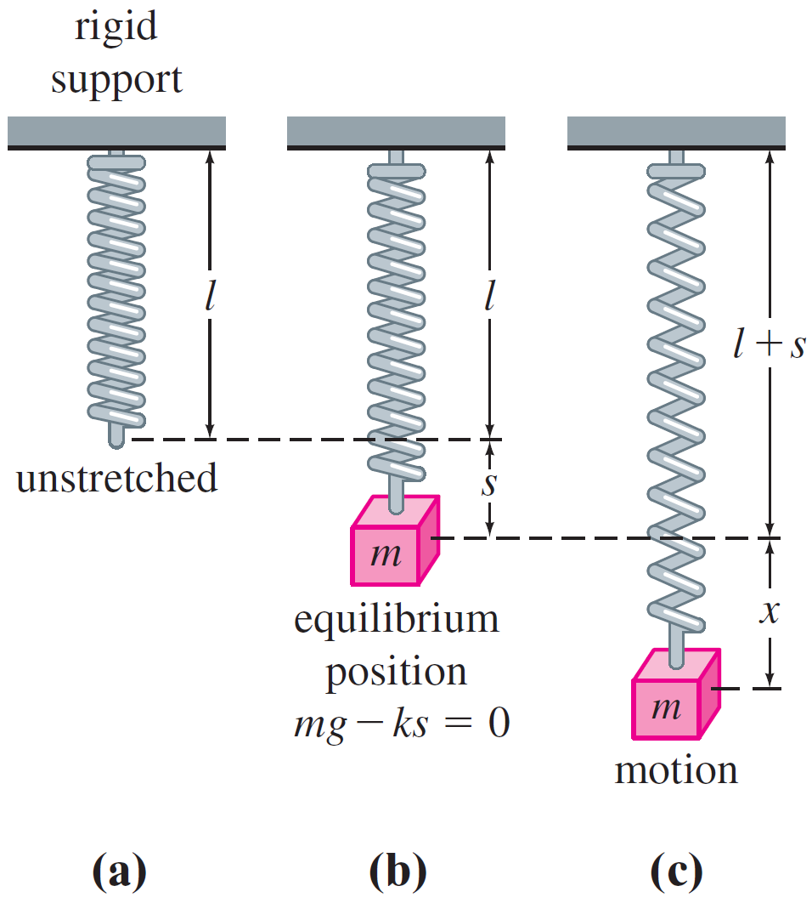
5.1.1 Spring/Mass Systems: Free Undamped Motion (2 of 27)
As indicated in the figure the condition of equilibrium is mg = ks or mg − ks = 0.
Spring/mass system
Figure 5.1.1

Slide 8
5.1.1 Spring/Mass Systems: Free Undamped Motion (3 of 27)
Now suppose the mass on the spring is set in motion by giving it an initial displacement (an elongation or a compression) and an initial velocity.
Let us assume that the motion takes place in a vertical line, that the displacements x(t) of the mass are measured along this line such that x = 0 corresponds to the equilibrium position, and that displacements measured below the equilibrium position are positive.

Slide 9
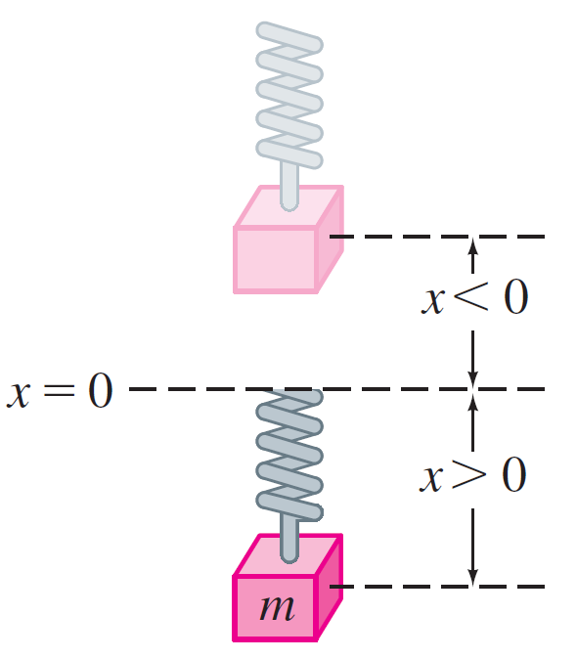
5.1.1 Spring/Mass Systems: Free Undamped Motion (4 of 27)
See the figure.
Direction below the equilibrium position is positive
Figure 5.1.2

Slide 10

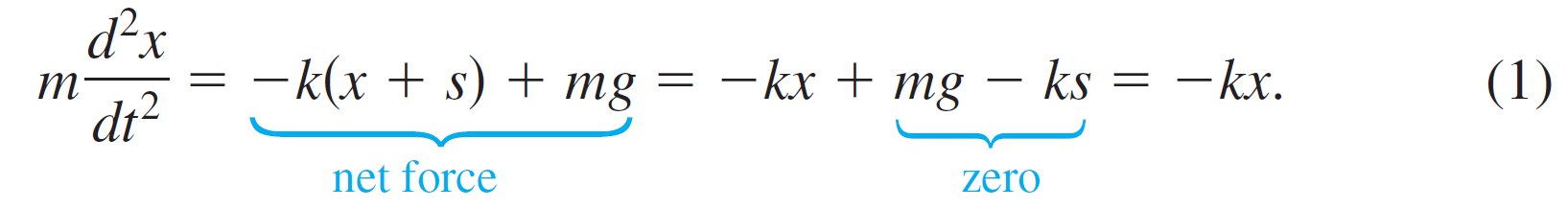
5.1.1 Spring/Mass Systems: Free Undamped Motion (5 of 27)
To construct a mathematical model that describes this dynamic case, we employ Newton’s second law of motion: the net or resultant force on a moving body of mass m is given by ΣF _{k} = ma, where
is its acceleration. If we further assume that the mass vibrates free of all other external forces—free motion—then Newton’s second law gives

Slide 11
5.1.1 Spring/Mass Systems: Free Undamped Motion (6 of 27)
The first term F₁ = −k(x + s) on the right-hand side of equation (1) is the restoring force of the spring; the negative sign indicates that this force acts opposite to the direction of motion.
The second term F₂ = mg is the weight of the mass which always acts in the downward or positive direction.

Slide 12

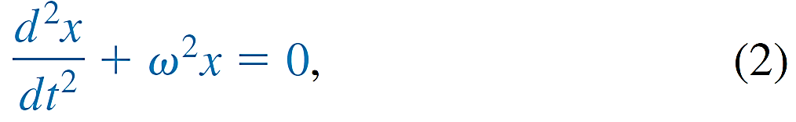

5.1.1 Spring/Mass Systems: Free Undamped Motion (7 of 27)
DE of Free Undamped Motion
By dividing (1) by the mass m, we obtain the second-order differential equation
Equation (2) is said to describe simple harmonic motion or free undamped motion.
where

Slide 13

5.1.1 Spring/Mass Systems: Free Undamped Motion (8 of 27)
Two obvious initial conditions associated with (2) are
x(0) = x₀ and x′(0) = x₁, the initial displacement and initial velocity of the mass, respectively.
Equation of Motion
To solve equation (2), we note that the solutions of its
auxiliary equation
are the complex numbers m₁ = ωi, m₂ = −ωi.

Slide 14
5.1.1 Spring/Mass Systems: Free Undamped Motion (9 of 27)
Thus from
we find the general solution of (2) to be
x(t) = c₁ cos ωt + c₂ sin ωt. (3)
The period of motion described by (3) is T = 2π ∕ ω. The number T represents the time (measured in seconds) it takes the mass to execute one cycle of motion.

Slide 15


5.1.1 Spring/Mass Systems: Free Undamped Motion (10 of 27)
The frequency of motion is f = 1 ∕ T = ω ∕ 2π and is the number of cycles completed each second. For example, if x(t) = 2 cos 3πt − 4 sin 3πt, then the period is T = 2π ∕ 3π = 2 ∕ 3 s, and the frequency is f = 3 ∕ 2 cycles/s.
From a graphical viewpoint the graph of x(t) repeats every
second, that is,
cycles of the graph are completed each second (or, equivalently, three cycles of the graph are completed every 2 seconds).

Slide 16

5.1.1 Spring/Mass Systems: Free Undamped Motion (11 of 27)
The number
(measured in radians per second) is called the circular frequency of the system.
Finally, when the initial conditions are used to determine the constants c₁ and c₂ in (3), we say that the resulting particular solution or response is the equation of motion.

Slide 17


Example 1 – Free Undamped Motion
A mass weighing 2 pounds stretches a spring 6 inches. At
t = 0 the mass is released from a point 8 inches below the
equilibrium position with an upward velocity of
Determine the equation of motion.
Solution:
Because we are using the engineering system of units, the measurements given in terms of inches must be converted into feet:

Slide 18


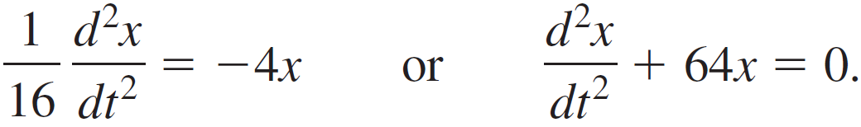

Example 1 – Solution (1 of 2)
In addition, we must convert the units of weight given in pounds into units of mass. From m = W ∕ g we have
slug. Also, from Hooke’s law, 2 =
implies that the spring constant is k = 4 lb ∕ ft. Hence (1) gives
The initial displacement and initial velocity are
where the negative sign in the last condition is a consequence of the fact that the mass is given an initial velocity in the negative, or upward, direction.

Slide 19


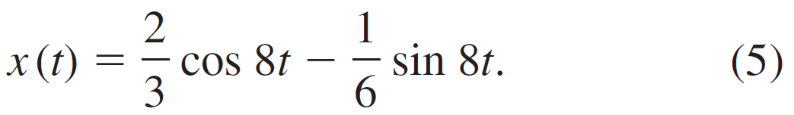
Example 1 – Solution (2 of 2)
Now
or ω = 8, so the general solution of the differential equation is
x(t) = c₁ cos 8t + c₂ sin 8t. (4)
Applying the initial conditions to x(t) and x′(t) gives
Thus the equation of motion is

Slide 20

5.1.1 Spring/Mass Systems: Free Undamped Motion (12 of 27)
Alternative Forms of x(t)
When c₁ ≠ 0 and c₂ ≠ 0, the actual amplitude A of free vibrations is not obvious from inspection of equation (3).
For example, although the mass in Example 1 is initially displaced
foot beyond the equilibrium position, the
amplitude of vibrations is a number larger than .

Slide 21

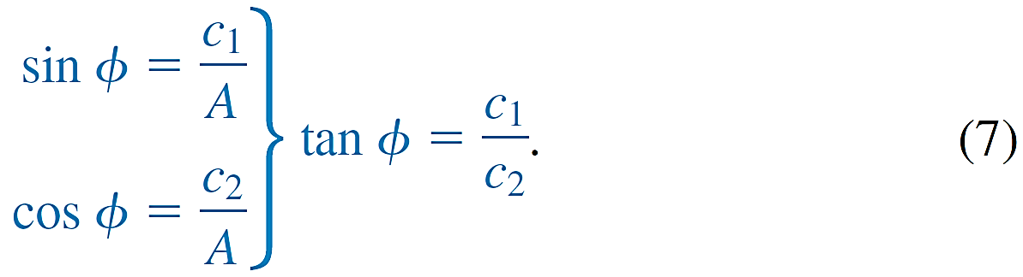
5.1.1 Spring/Mass Systems: Free Undamped Motion (13 of 27)
Hence it is often convenient to convert a solution of form (3) to the simpler form
x(t) = A sin(ωt + Φ), (6)
where
and Φ is a phase angle defined by

Slide 22
5.1.1 Spring/Mass Systems: Free Undamped Motion (14 of 27)
To verify this, we expand (6) by the addition formula for the sine function:
A sin ωt cos Φ + A cos ωt sin Φ
= (A sin Φ) cos ωt + (A cos Φ) sin ωt. (8)

Slide 23
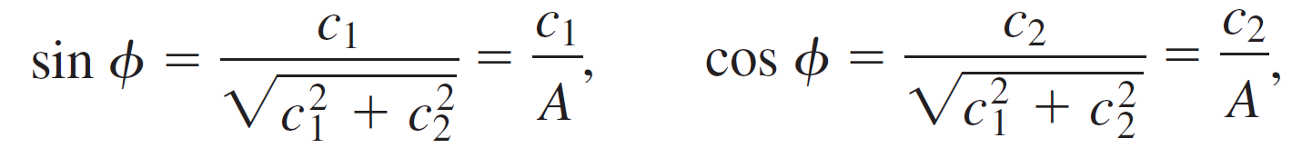
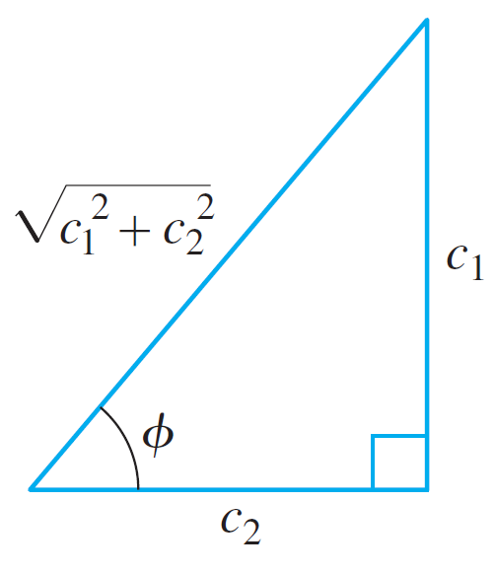
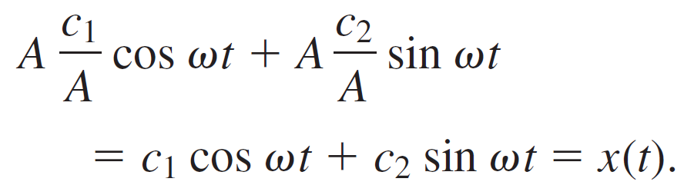
5.1.1 Spring/Mass Systems: Free Undamped Motion (15 of 27)
It follows from the figure that if Φ is defined by
then (8) becomes
A relationship between c₁ > 0, c₂ > 0 and phase angle Φ
Figure 5.1.3

Slide 24
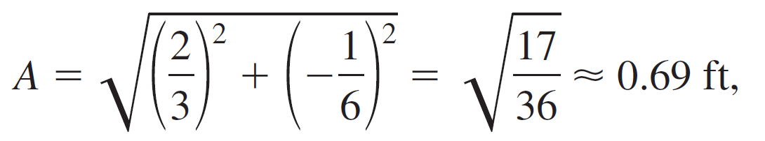
Example 2 – Alternative Form of Solution (5) (1 of 3)
In view of the foregoing discussion we can write solution (5) in the alternative form x(t) = A sin(8t + Φ). Computation of the amplitude is straightforward,
but some care should be exercised in computing the phase angle Φ defined by (7).

Slide 25
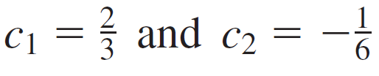

Example 2 – Alternative Form of Solution (5) (2 of 3)
With
we find tan Φ = −4, and a calculator then gives
= −1.326 rad.
This is not the phase angle, since
is located in the fourth quadrant and therefore contradicts the fact that
sin Φ > 0 and cos Φ < 0 because c₁ > 0 and c₂ < 0.
Hence we must take Φ to be the second-quadrant angle
Φ = π + (−1.326) = 1.816 rad.

Slide 26
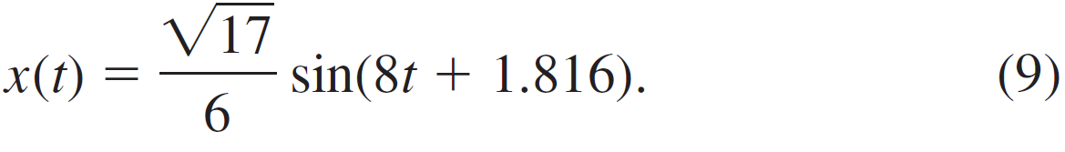
Example 2 – Alternative Form of Solution (5) (3 of 3)
Thus (5) is the same as
The period of this function is T = 2π ∕ 8 = π ∕ 4 s.

Slide 27
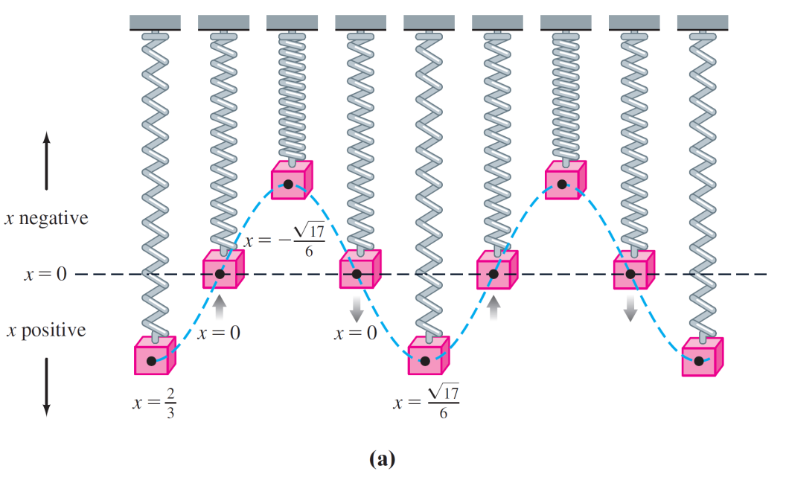
5.1.1 Spring/Mass Systems: Free Undamped Motion (16 of 27)
Graphical Interpretation
Figure (a) illustrates the mass in Example 2
going through approximately two complete cycles of motion.
Simple harmonic motion
Figure 5.1.4

Slide 28



5.1.1 Spring/Mass Systems: Free Undamped Motion (17 of 27)
Reading left to right, the first five positions (marked with black dots) correspond to the initial position of the mass below the equilibrium position
the mass passing through the equilibrium position for the first time heading upward (x = 0), the mass at its extreme displacement above the equilibrium position
, the mass at the equilibrium position for the second time heading downward (x = 0), and the mass at its extreme displacement below the equilibrium position .

Slide 29
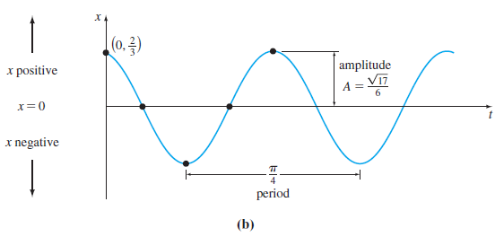
5.1.1 Spring/Mass Systems: Free Undamped Motion (18 of 27)
The black dots on the graph of (9), given in figure (b), also agree with the five positions just given.
Simple harmonic motion
Figure 5.1.4

Slide 30
5.1.1 Spring/Mass Systems: Free Undamped Motion (19 of 27)
Note, however, that in Figure 5.1.4(b) the positive direction in the tx-plane is the usual upward direction and so is opposite to the positive direction indicated in Figure 5.1.4(a).
Hence the solid blue graph representing the motion of the mass in Figure 5.1.4(b) is the reflection through the t-axis of the blue dashed curve in Figure 5.1.4(a).

Slide 31
5.1.1 Spring/Mass Systems: Free Undamped Motion (20 of 27)
Form (6) is very useful because it is easy to find values of time for which the graph of x(t) crosses the positive t-axis (the line x = 0).
We observe that sin(ωt + Φ) = 0 when ωt + Φ = nπ, where n is a nonnegative integer.

Slide 32
5.1.2 Spring/Mass Systems: Free Damped Motion

Slide 33
5.1.2 Spring/Mass Systems: Free Damped Motion (1 of 13)
DE of Free Damped Motion
In the study of mechanics, damping forces acting on a body are considered to be proportional to a power of the instantaneous velocity.
In particular, we shall assume throughout the subsequent discussion that this force is given by a constant multiple of dx ∕ dt.

Slide 34
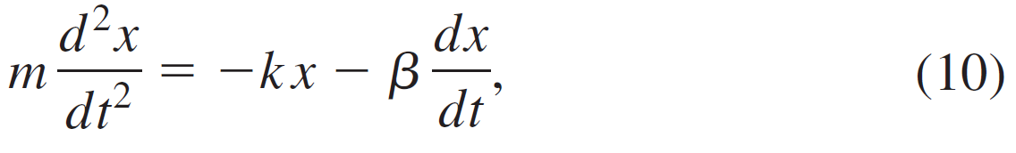
5.1.2 Spring/Mass Systems: Free Damped Motion (2 of 13)
When no other external forces are impressed on the system, it follows from Newton’s second law that
where β is a positive damping constant and the negative sign is a consequence of the fact that the damping force acts in a direction opposite to the motion.

Slide 35
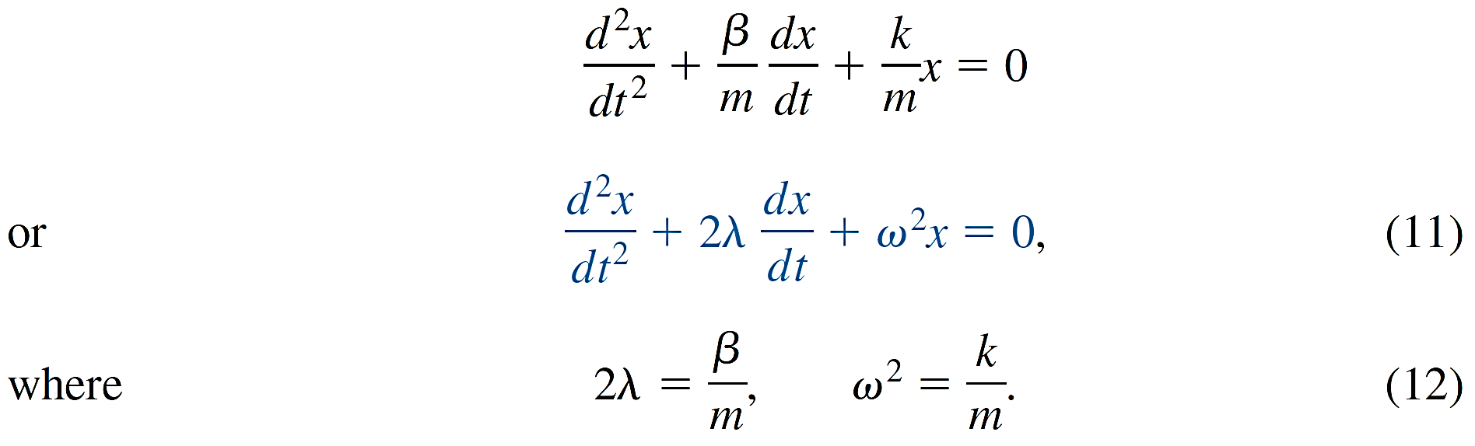
5.1.2 Spring/Mass Systems: Free Damped Motion (3 of 13)
Dividing (10) by the mass m, we find that the differential equation of free damped motion is

Slide 36



5.1.2 Spring/Mass Systems: Free Damped Motion (4 of 13)
The symbol 2λ is used only for algebraic convenience because the auxiliary equation is
and the corresponding roots are then
We can now distinguish three possible cases depending on the algebraic sign of
Since each solution contains the damping factor
λ > 0, the displacements of the mass become negligible as time t increases.

Slide 37


5.1.2 Spring/Mass Systems: Free Damped Motion (5 of 13)
In this situation the system is said to be overdamped because the damping coefficient β is large when compared to the spring constant k.
The corresponding solution of (11) is

Slide 38
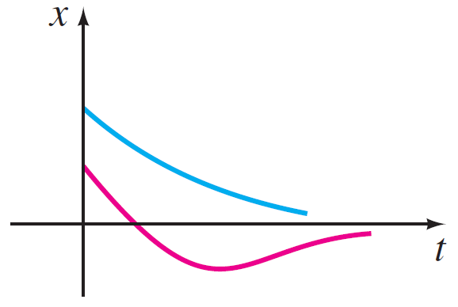
5.1.2 Spring/Mass Systems: Free Damped Motion (6 of 13)
This equation represents a smooth and nonoscillatory motion. The figure shows two possible graphs of x(t).
Motion of an overdamped system
Figure 5.1.8

Slide 39


5.1.2 Spring/Mass Systems: Free Damped Motion (7 of 13)
The system is said to be critically damped because any slight decrease in the damping force would result in oscillatory motion.
The general solution of (11) is

Slide 40
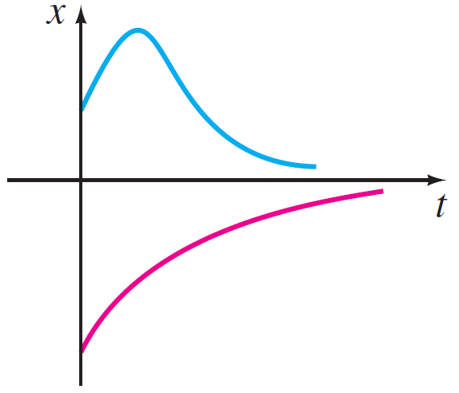
5.1.2 Spring/Mass Systems: Free Damped Motion (8 of 13)
Some graphs of typical motion are given in the figure.
Motion of a critically damped system
Figure 5.1.9
Notice that the motion is quite similar to that of an overdamped system. It is also apparent from (14) that the mass can pass through the equilibrium position at most one time.

Slide 41

5.1.2 Spring/Mass Systems: Free Damped Motion (9 of 13)
In this case the system is said to be underdamped, since the damping coefficient is small in comparison to the spring constant. The roots m₁ and m₂ are now complex:
Thus the general solution of equation (11) is

Slide 42


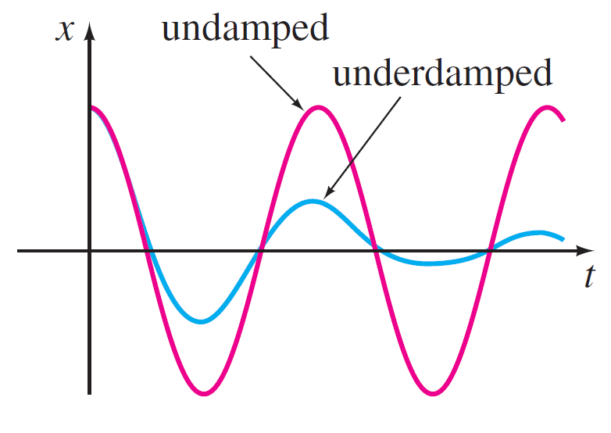
5.1.2 Spring/Mass Systems: Free Damped Motion (10 of 13)
As indicated in the figure, the motion described by (15) is oscillatory; but because of the coefficient
the amplitudes of vibration
Motion of an underdamped system
Figure 5.1.10

Slide 43
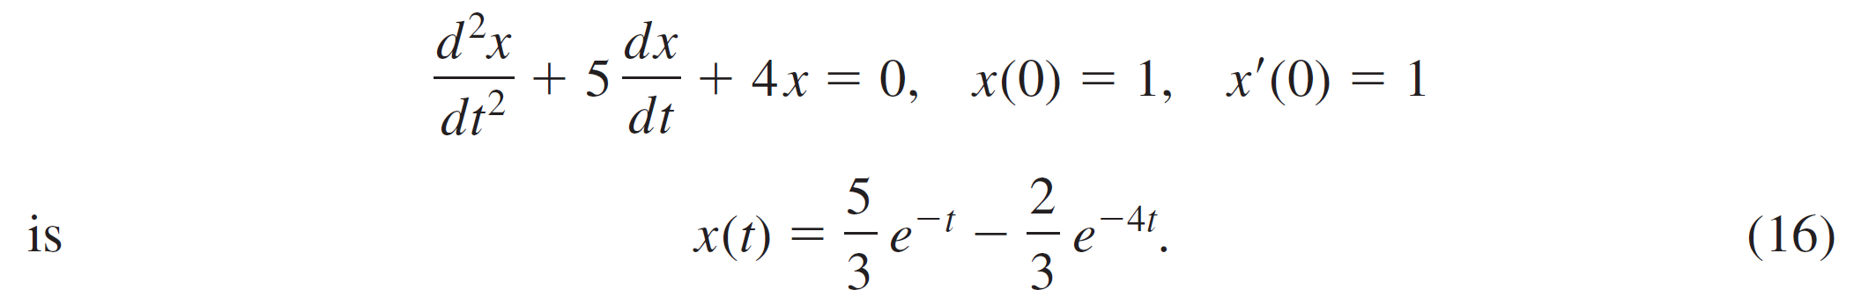
Example 3 – Overdamped Motion (1 of 4)
It is readily verified that the solution of the initial-value problem
The problem can be interpreted as representing the overdamped motion of a mass on a spring. The mass is initially released from a position 1 unit below the equilibrium position with a downward velocity of 1 ft ∕ s.

Slide 44



Example 3 – Overdamped Motion (2 of 4)
To graph x(t), we find the value of t for which the function has an extremum—that is, the value of time for which the first derivative (velocity) is zero. Differentiating (16) gives
so x′(t) = 0 implies that
It follows from the first derivative test, as well as our physical intuition, that x(0.157) = 1.069 ft is actually a maximum. In other words, the mass attains an extreme displacement of 1.069 feet below the equilibrium position.

Slide 45


Example 3 – Overdamped Motion (3 of 4)
We should also check to see whether the graph crosses the t-axis—that is, whether the mass passes through the equilibrium position. This cannot happen in this instance because the equation x(t) = 0, or
has the physically irrelevant solution

Slide 46
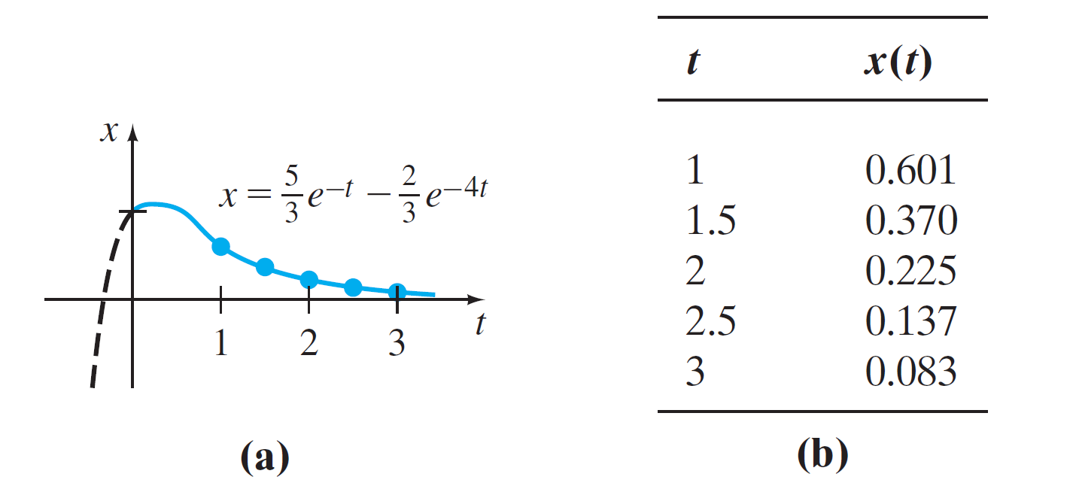
Example 3 – Overdamped Motion (4 of 4)
The graph of x(t), along with some other pertinent data, is given in the figure.
Overdamped system in Example 3
Figure 5.1.11

Slide 47

Example 4 – Critically Damped Motion
A mass weighing 8 pounds stretches a spring 2 feet. Assuming that a damping force numerically equal to 2 times the instantaneous velocity acts on the system, determine the equation of motion if the mass is initially released from the equilibrium position with an upward velocity of 3 ft ∕ s.
Solution:
From Hooke’s law we see that 8 = k(2) gives k = 4 lb ∕ ft and that W = mg gives
slug.

Slide 48

Example 4 – Solution (1 of 3)
The differential equation of motion is then
The auxiliary equation for (17) is
so m₁ = m₂ = −4. Hence the system is critically damped, and

Slide 49



Example 4 – Solution (2 of 3)
Applying the initial conditions x(0) = 0 and x′(0) = 23, we find, in turn, that c₁ = 0 and c₂ = −3. Thus the equation of motion is
To graph x(t), we proceed as in Example 3. From
we see that x′(t) = 0 when
The corresponding extreme displacement is

Slide 50
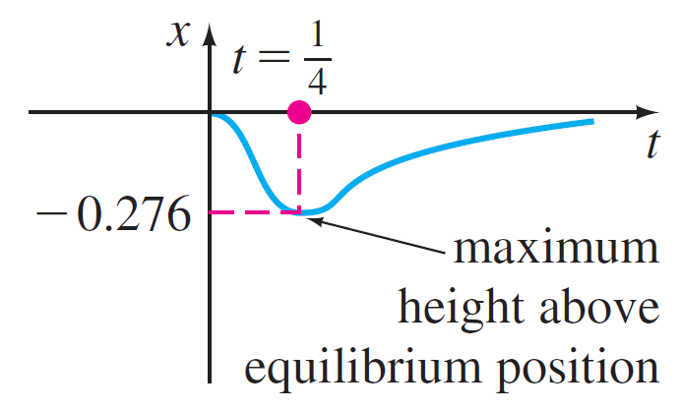
Example 4 – Solution (3 of 3)
As shown in the figure, we interpret this value to mean that the mass reaches a maximum height of 0.276 foot above the equilibrium position.
Critically damped system in Example 4
Figure 5.1.12

Slide 51
Example 5 – Underdamped Motion
A mass weighing 16 pounds is attached to a 5-foot-long spring. At equilibrium the spring measures 8.2 feet. If the mass is initially released from rest at a point 2 feet above the equilibrium position, find the displacements x(t) if it is further known that the surrounding medium offers a resistance numerically equal to the instantaneous velocity.
Solution:
The elongation of the spring after the mass is attached is 8.2 − 5 = 3.2 ft, so it follows from Hooke’s law that
16 = k(3.2) or k = 5 lb ∕ ft.

Slide 52


Example 5 – Solution (1 of 2)
slug, so the differential equation is given by
In addition,
Proceeding, we find that the roots of
are m₁ = −1 + 3i and m₂ = −1 − 3i, which then implies that the system is underdamped, and

Slide 53

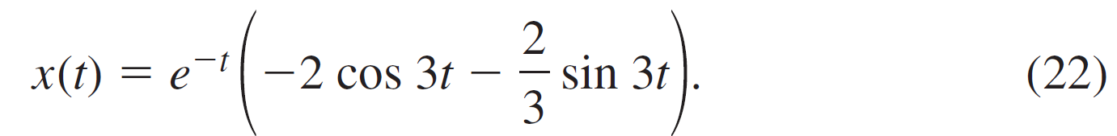
Example 5 – Solution (2 of 2)
Finally, the initial conditions x(0) = −2 and x′(0) = 0 yield
c₁ = −2 and
so the equation of motion is

Slide 54

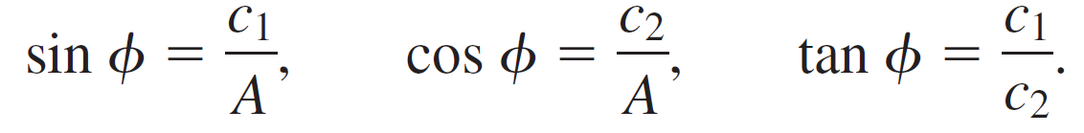
5.1.2 Spring/Mass Systems: Free Damped Motion (11 of 13)
Alternative Form of x(t)
We can write any solution
in the alternative form
and the phase angle Φ is determined from the equations

Slide 55



5.1.2 Spring/Mass Systems: Free Damped Motion (12 of 13)
is sometimes called the damped amplitude of vibrations. Because (23) is not a periodic function, the number
The coefficient
is called the quasi period and
is the quasi frequency.
The quasi period is the time interval between two successive maxima of x(t).

Slide 56

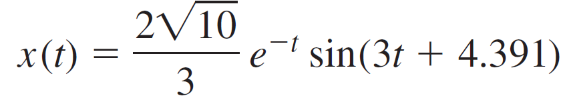
5.1.2 Spring/Mass Systems: Free Damped Motion (13 of 13)
You should verify, for the equation of motion in Example 5, that
and Φ = 4.391.
Therefore an equivalent form of (22) is

Slide 57
5.1.3 Spring/Mass Systems: Driven Motion

Slide 58
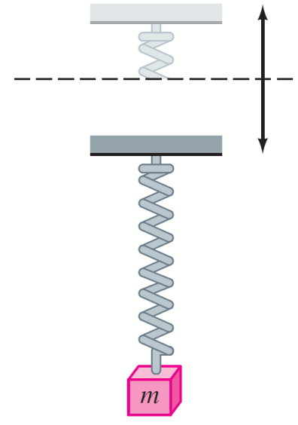
5.1.3 Spring/Mass Systems: Driven Motion (1 of 11)
DE of Driven Motion with Damping
Suppose we now take into consideration an external force f(t) acting on a vibrating mass on a spring. For example f(t) could represent a driving force causing an oscillatory vertical motion of the support of the spring. See the figure.
Oscillatory vertical motion of the support
Figure 5.1.13

Slide 59
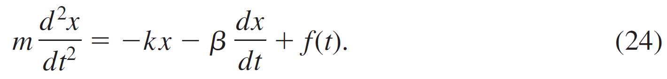
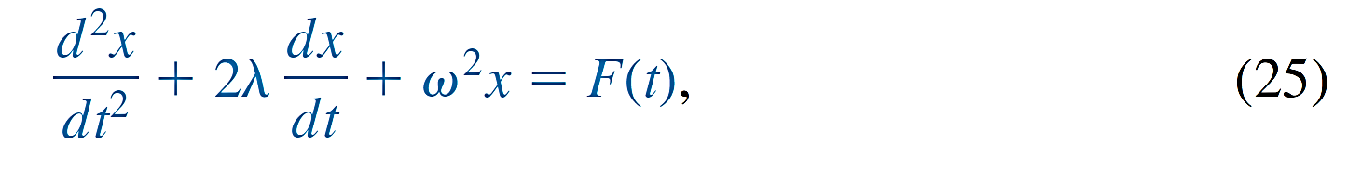

5.1.3 Spring/Mass Systems: Driven Motion (2 of 11)
The inclusion of f (t) in the formulation of Newton’s second law gives the differential equation of driven or forced motion:
Dividing (24) by m gives
where F(t) = f(t) ∕ m and, as in the preceding section,

Slide 60
5.1.3 Spring/Mass Systems: Driven Motion (3 of 11)
To solve the latter nonhomogeneous equation, we can use either the method of undetermined coefficients or variation of parameters.

Slide 61

Example 6 – Interpretation of an Initial-Value Problem
Interpret and solve the initial-value problem
Solution:
We can interpret the problem to represent a vibrational
system consisting of a mass (m =
slug or kilogram)
attached to a spring (k = 2 lb ∕ ft or N ∕ m).

Slide 62
Example 6 – Solution (1 of 4)
The mass is initially released from rest 1 ∕ 2 unit (foot or meter) below the equilibrium position. The motion is damped (β = 1.2) and is being driven by an external periodic (T = π ∕ 2 s) force beginning at t = 0.
Intuitively, we would expect that even with damping, the system would remain in motion until such time as the forcing function was “turned off,” in which case the amplitudes would diminish. However, as the problem is given, f(t) = 5 cos 4t will remain “on” forever.

Slide 63
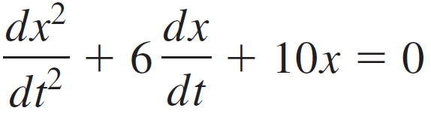
Example 6 – Solution (2 of 4)
We first multiply the differential equation in (26) by 5 and solve
by the usual methods.
Because m₁ = −3 + i, m₂ = −3 − i, it follows that
Using the method of undetermined coefficients, we assume a particular solution of the form x _{p}(t) = A cos 4t + B sin 4t.

Slide 64
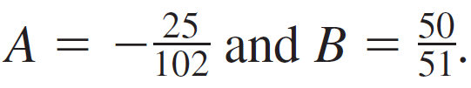
Example 6 – Solution (3 of 4)
Differentiating x _{p}(t) and substituting into the DE gives
x″ _{p} + 6x′ _{p} + 10x _{p} = (−6A + 24B) cos 4t + (−24A − 6B) sin 4t
= 25 cos 4t.
The resulting system of equations
−6A + 24B = 25, −24A − 6B = 0
yields
It follows that

Slide 65


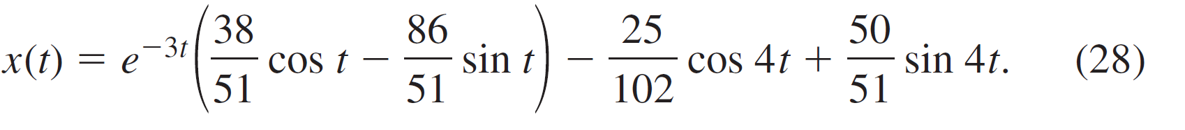
Example 6 – Solution (4 of 4)
When we set t = 0 in the above equation, we obtain
By differentiating the expression and then setting t = 0,
we also find that
Therefore the equation of motion is

Slide 66

5.1.3 Spring/Mass Systems: Driven Motion (4 of 11)
Transient and Steady-State Terms
When F is a periodic function, such as F(t) = F₀ sin γt or
F(t) = F₀ cos γt, the general solution of (25) for λ > 0 is the sum of a nonperiodic function x _{c}(t) and a periodic function x _{p}(t).
Moreover, x _{c}(t) dies off as time increases—that is,
Thus for large values of time, the displacements of the mass are closely approximated by the particular solution x _{p}(t).

Slide 67


5.1.3 Spring/Mass Systems: Driven Motion (5 of 11)
The complementary function x _{c}(t) is said to be a transient term or transient solution, and the function x _{p}(t), the part of the solution that remains after an interval of time, is called a steady-state term or steady-state solution.
Note therefore that the effect of the initial conditions on a spring/mass system driven by F is transient.
In the particular solution (28),
is a
transient term, and
is a steady-state term.

Slide 68
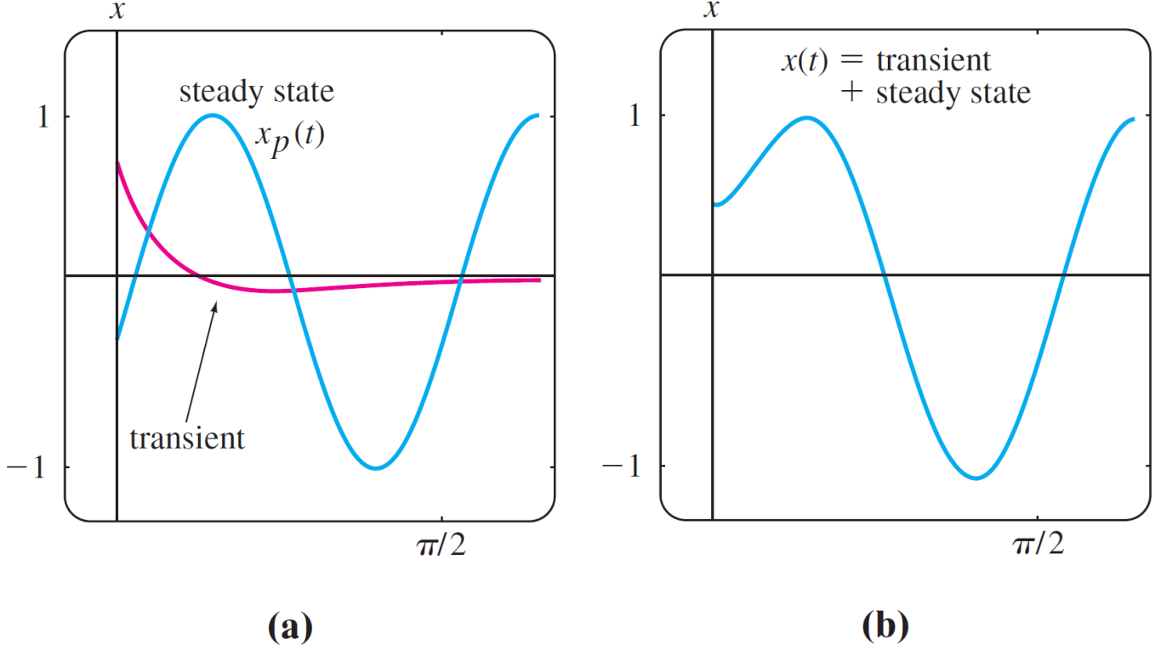
5.1.3 Spring/Mass Systems: Driven Motion (6 of 11)
The graphs of these two terms and the solution (28) are given in figures (a) and (b), respectively.
Graph of solution in (28) of Example 6
Figure 5.1.14

Slide 69
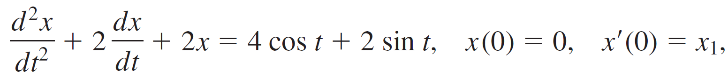
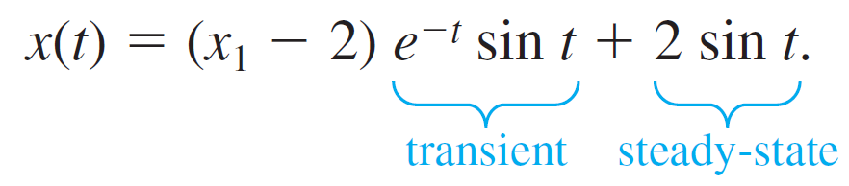
Example 7 – Transient/Steady-State Solutions (1 of 3)
The solution of the initial-value problem
where x₁ is constant, is given by

Slide 70
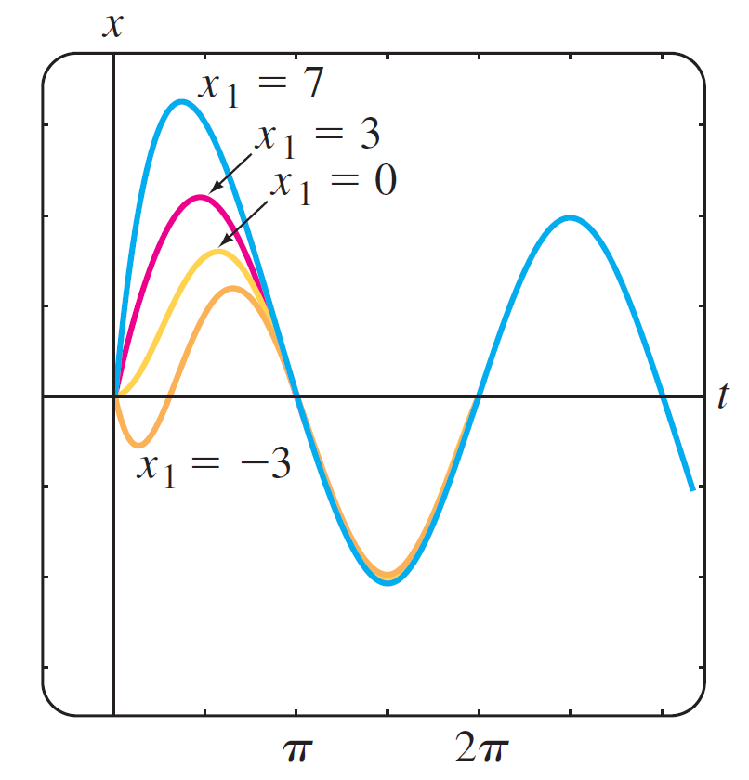
Example 7 – Transient/Steady-State Solutions (2 of 3)
Solution curves for selected values of the initial velocity x₁ are shown in the figure.
Graph of solution in Example 7 for various initial velocities x₁
Figure 5.1.15

Slide 71
Example 7 – Transient/Steady-State Solutions (3 of 3)
The graphs show that the influence of the transient term is negligible for about t > 3π ∕ 2.

Slide 72
5.1.3 Spring/Mass Systems: Driven Motion (7 of 11)
DE of Driven Motion without Damping
With a periodic impressed force and no damping force, there is no transient term in the solution of a problem.
Also, we shall see that a periodic impressed force with a frequency near or the same as the frequency of free undamped vibrations can cause a severe problem in any oscillatory mechanical system.

Slide 73
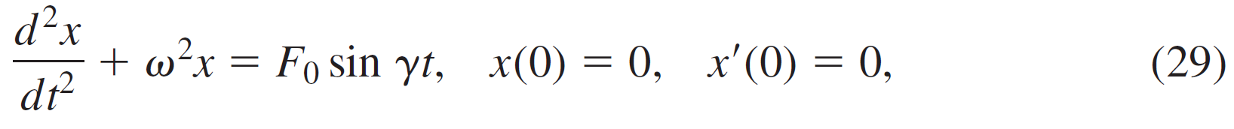
Example 8 – Undamped Forced Motion
Solve the initial-value problem
where F₀ is a constant and γ ≠ ω.
Solution:
The complementary function is x _{c}(t) = c₁ cos ωt + c₂ sin ωt. To obtain a particular solution, we assume
x _{p}(t) = A cos γt + B sin γt so that

Slide 74

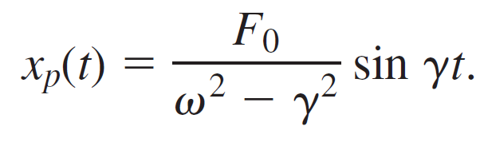
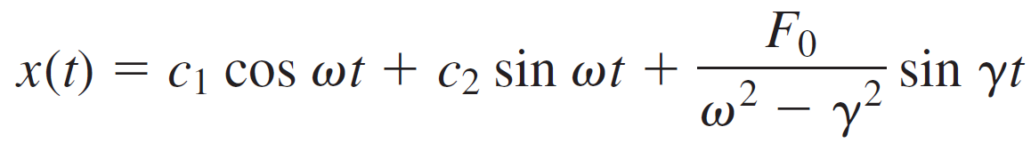

Example 8 – Solution (1 of 2)
Equating coefficients immediately gives A = 0 and
Applying the given initial conditions to the general solution
yields c₁ = 0 and c₂ =

Slide 75
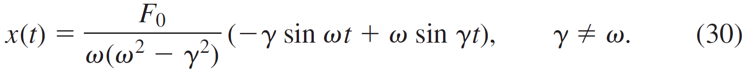
Example 8 – Solution (2 of 2)
Thus the solution is

Slide 76

5.1.3 Spring/Mass Systems: Driven Motion (8 of 11)
Pure Resonance
Although equation (30) is not defined for γ = ω, it is interesting to observe that its limiting value as
can be obtained by applying L’Hôpital’s Rule.
This limiting process is analogous to “tuning in” the frequency of the driving force (γ ∕ 2π) to the frequency of free vibrations (ω ∕ 2π).
Intuitively, we expect that over a length of time we should be able to substantially increase the amplitudes of vibration.

Slide 77
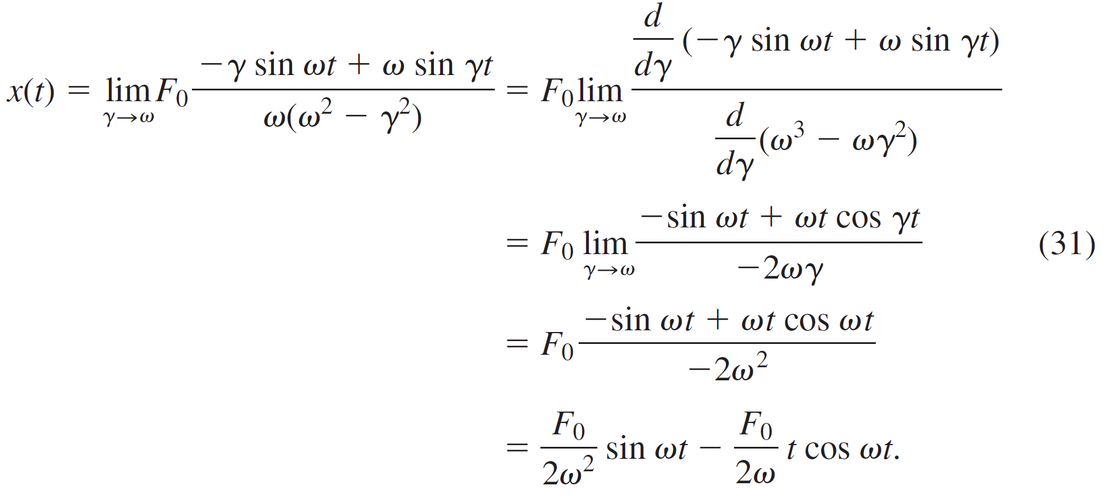
5.1.3 Spring/Mass Systems: Driven Motion (9 of 11)
For γ = ω we define the solution to be

Slide 78


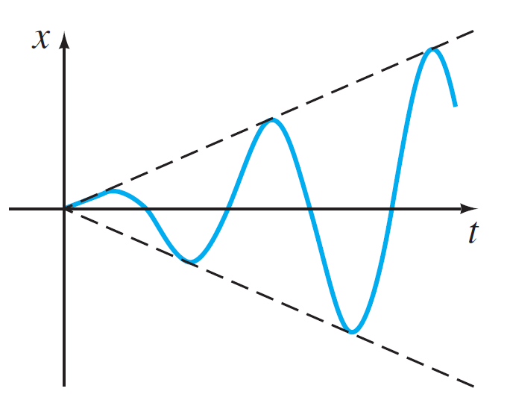
5.1.3 Spring/Mass Systems: Driven Motion (10 of 11)
As suspected, when
the displacements become large; in fact,
. When t _{n} = nπ ∕ ω, n = 1, 2, . . . . The phenomenon that we have just described is known as pure resonance. The graph given in the figure shows typical motion in this case.
Pure resonance
Figure 5.1.16

Slide 79
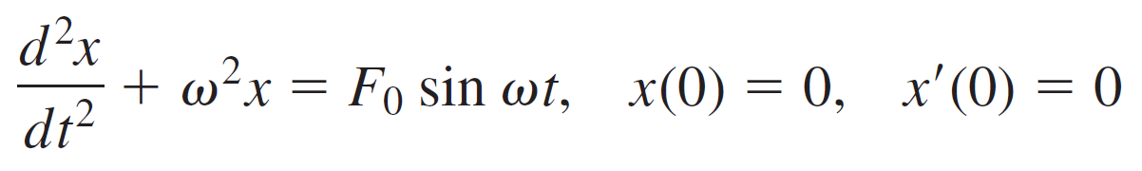
5.1.3 Spring/Mass Systems: Driven Motion (11 of 11)
In conclusion it should be noted that there is no actual need to use a limiting process on (30) to obtain the solution for
γ = ω. Alternatively, the last equation in (31) can be obtained by solving the initial-value problem
directly by the methods of undetermined coefficients or variation of parameter.

